Slide 1

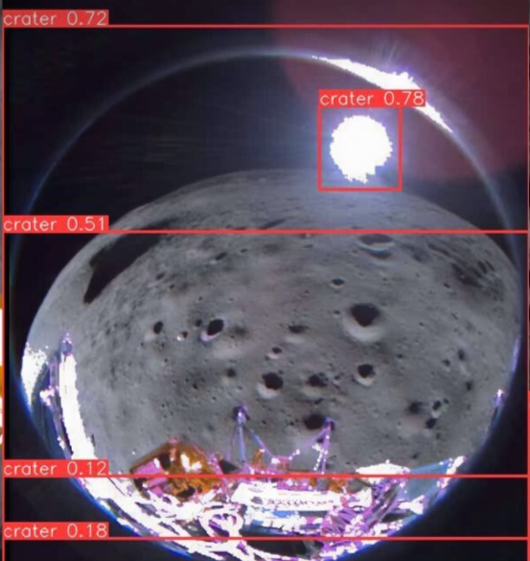
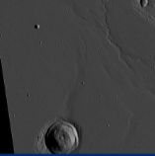
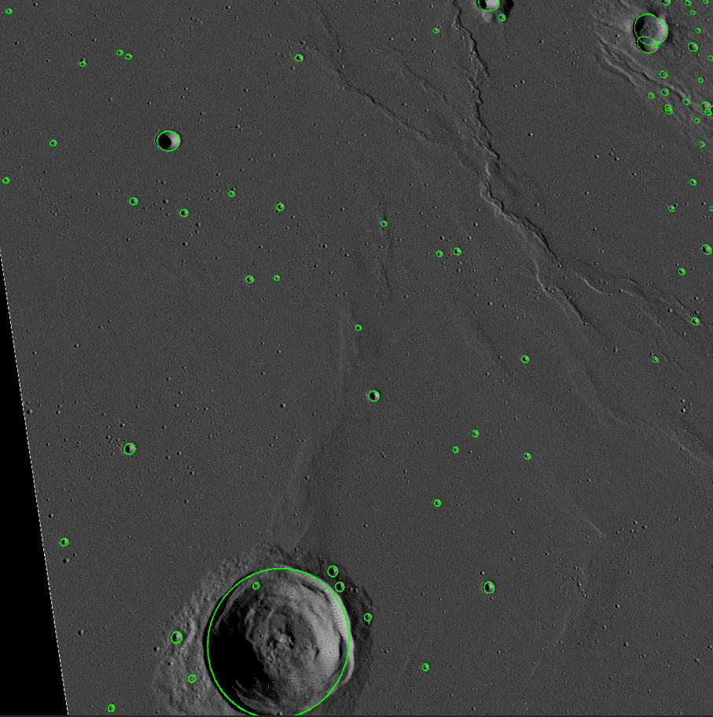
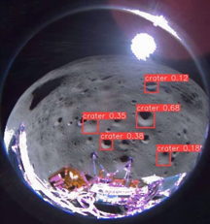

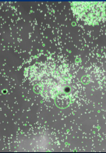
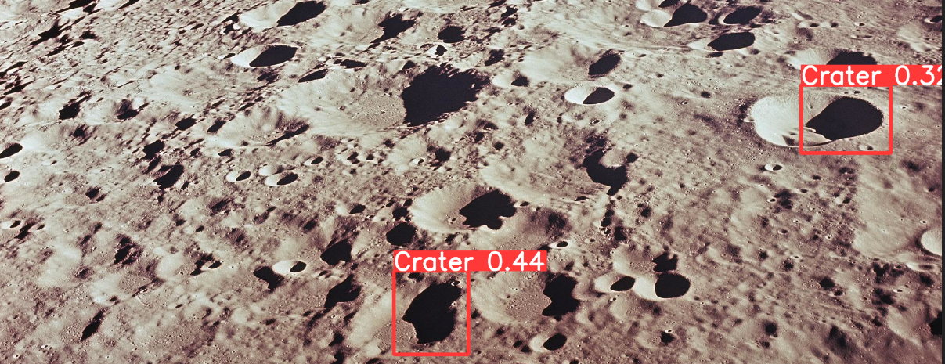

Deep-Learning Crater Detection and Segmentation for Autonomous Navigation
Pratheek Ramakrishna and Mehiret Aga
Key terms
Yolo V8: An algorithm used to train AI given a data set consisting of images and labels.
MATLAB: Programming software that we used to generate our images of the moon
DEM: Digital Elevation Map. Essentially a photo of a part of the moon with geographical information
Lunar Crater Database Robbins: Database of about 1.3 million craters moon that are > 1-2km in diameter
Why Do This?
After research of existing datasets through websites like Roboflow of crater detection training datasets we concluded that the vast majority of data sets consisted of a top down view of craters.
After training AI on this limited dataset, we tested on moon crater images taken from oblique angles.
Results
Mentored by Ike Witte
What did We Do?
Make a new dataset to train AI with rendered oblique images of craters.
How?
1. Correlate all the craters on that are within the specified region of our DEM to the craters in Lunar Crater Database Robbins using MATLAB programming
Use the coordinates given for each crater and determine if the crater is even located on the DEM
If crater is located on the DEM, plot the center of the crater as well of the diameter of the crater as listed in the spreadsheet
Perform operation for 1.3 million craters
How?
2. Render images of the moon and annotate the images to identify craters using MATLAB script
Images are rendered through a MATLAB script that takes in the DEM and renders an image of the crater
3. Train the Yolo V8 algorithm
Inputted rendered images and the coordinates of the craters
AI detects a pattern and then essentially quizzes itself to ensure that it is, based off the given pattern, detecting craters properly
Detection using Roboflow crater training dataset
Detection using lunar crater dataset
Summary
New crater detection model excelled at distinguishing between craters and other objects and had few false positives. However, more data may be required to identify smaller craters.
Special thanks to Ike Witte and ASPIRE program for mentorship and guidance

